Slide 1
Travel Wishlist Part 2

Slide 2
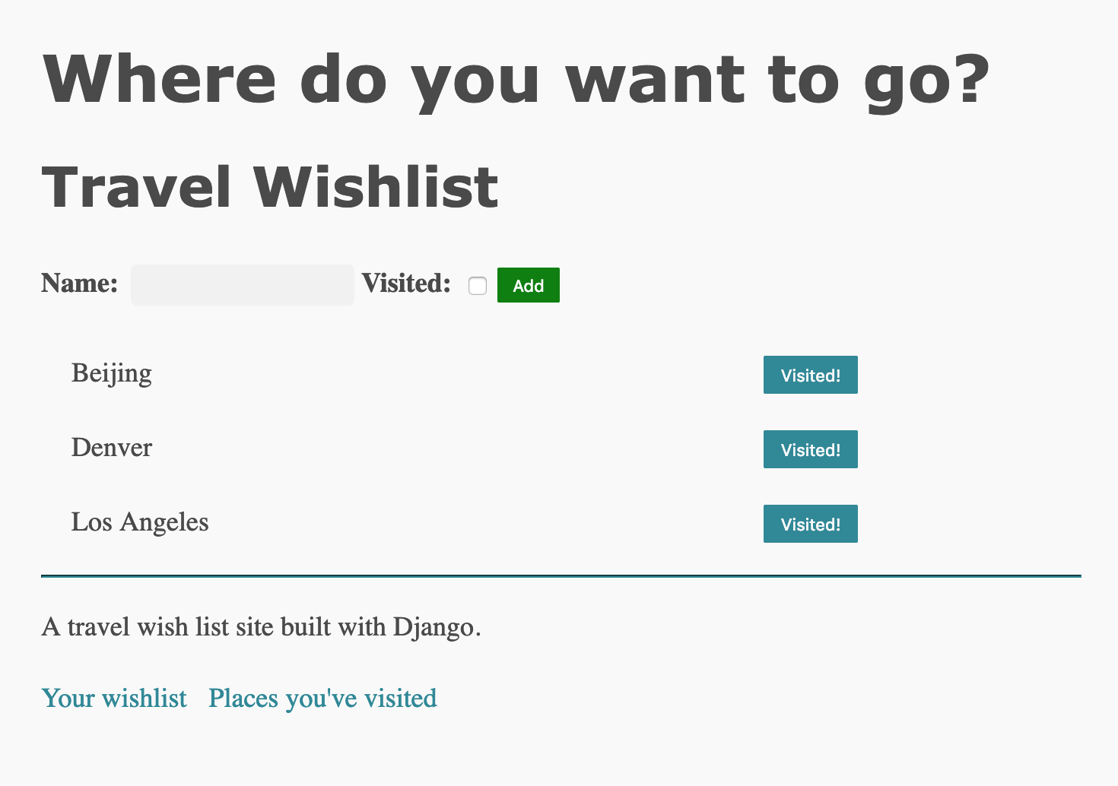
Start with your wish list site
List of places
List of visited places

Slide 3
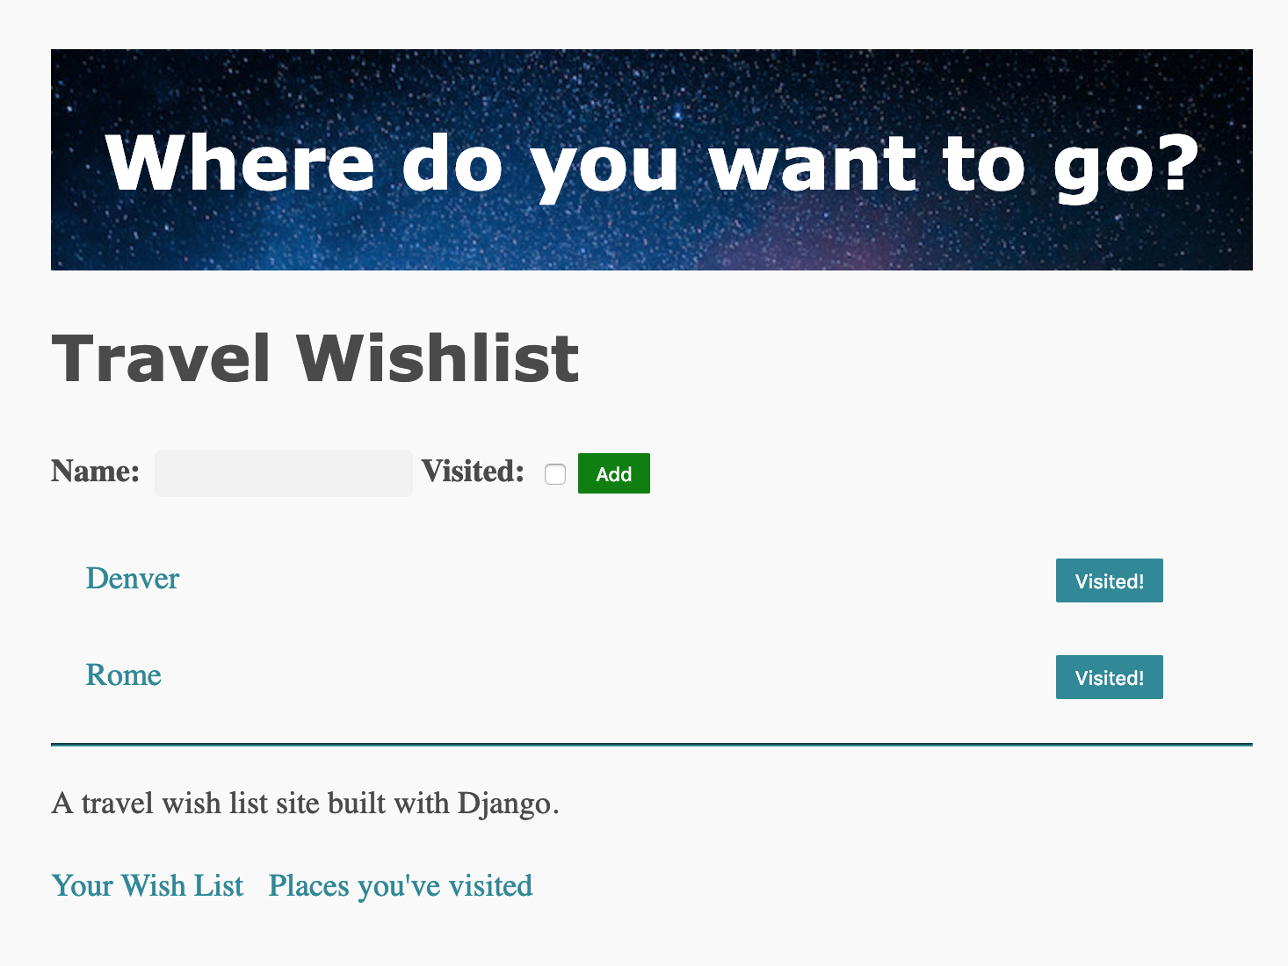
Add features
Detail page for place, links from wish list and visited list
Delete place
Add date, notes, and upload a photo for a place

Slide 4
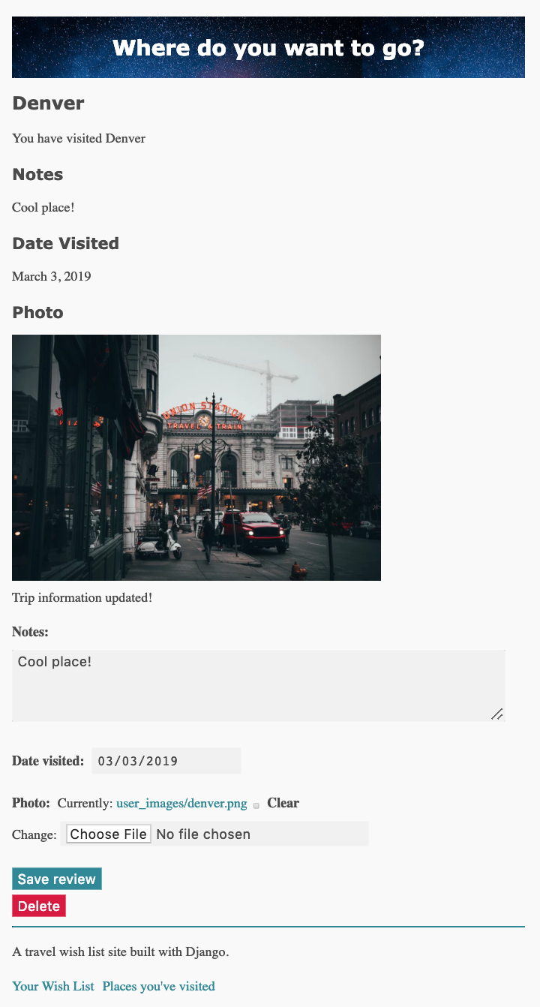
Place detail – for visited places
Add/edit photo, notes, date visited

Slide 5
Code at
https://github.com/claraj/wishlist_with_uploads

Slide 6
Users: uploads, per-user wishlists
For security and cost reasons, it's a good idea to manage who can upload files to your server
For this app, we'll use the built-in admin login functionality to log users in
Only users who have created an account via createsuperuser will be able to log in – we won't create our own login flow
You will do this, in Project 5
We will associate places with a user
So, each user will be able to make their own wishlist
A Place will belong to a User

Slide 7
Modifications to Place model
travel_wishlist/models.py
Add these fields:
User, foreign key to Django's built-in User model
notes, TextField
date_visited, DateField
photo, ImageField
And modify the __str__ method
Code next slide

Slide 8
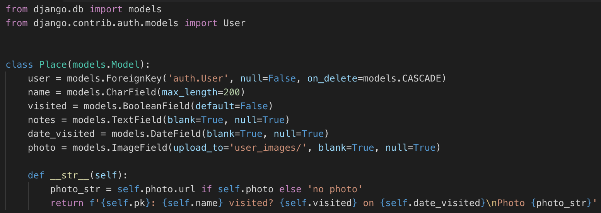
travel_wishlist/models.py

Slide 9
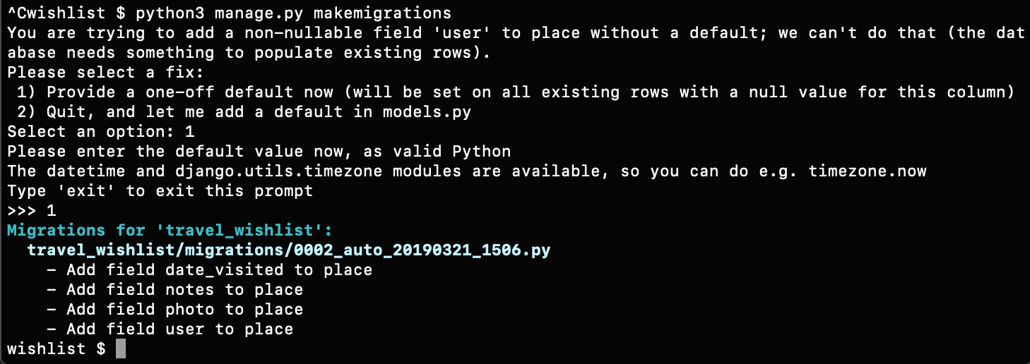
Migrations
The database needs to be changed to add columns for the new fields
python manage.py makemigrations
If you already have data in your tables, you'll get this prompt. Enter 1 to provide a one-off default, then enter 1 to associate all the existing places with user 1

Slide 10
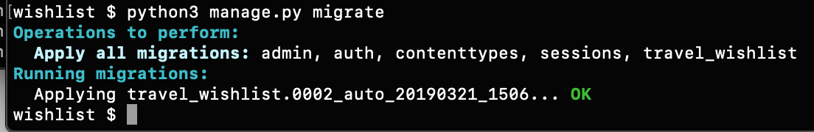
Migrate
python manage.py migrate

Slide 11
Require login
Add the @require_login decorator to all of the methods in travel_wishlist/views.py
When you reload your site, you'll be redirected to the admin login
Sign in, and then you should be able to access the site again
Code, next slide

Slide 12
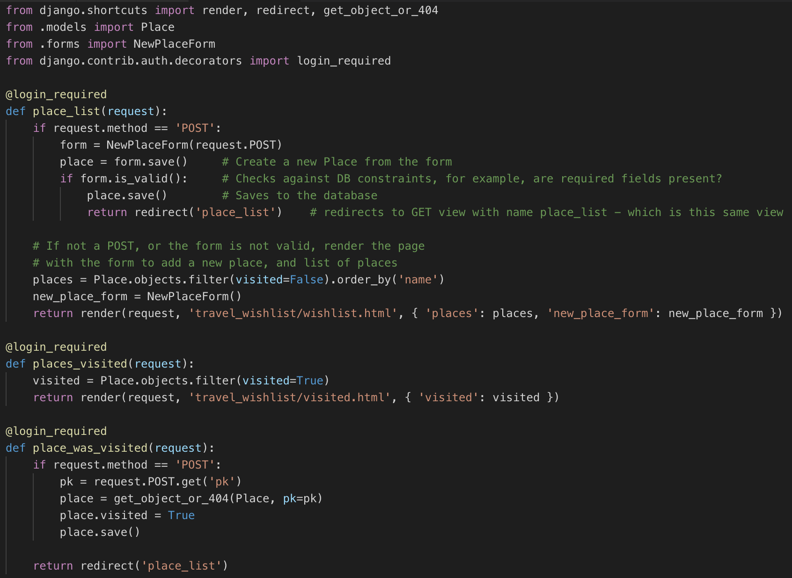
travel_wishlist/views.py
Add @login_required to all functions

Slide 13
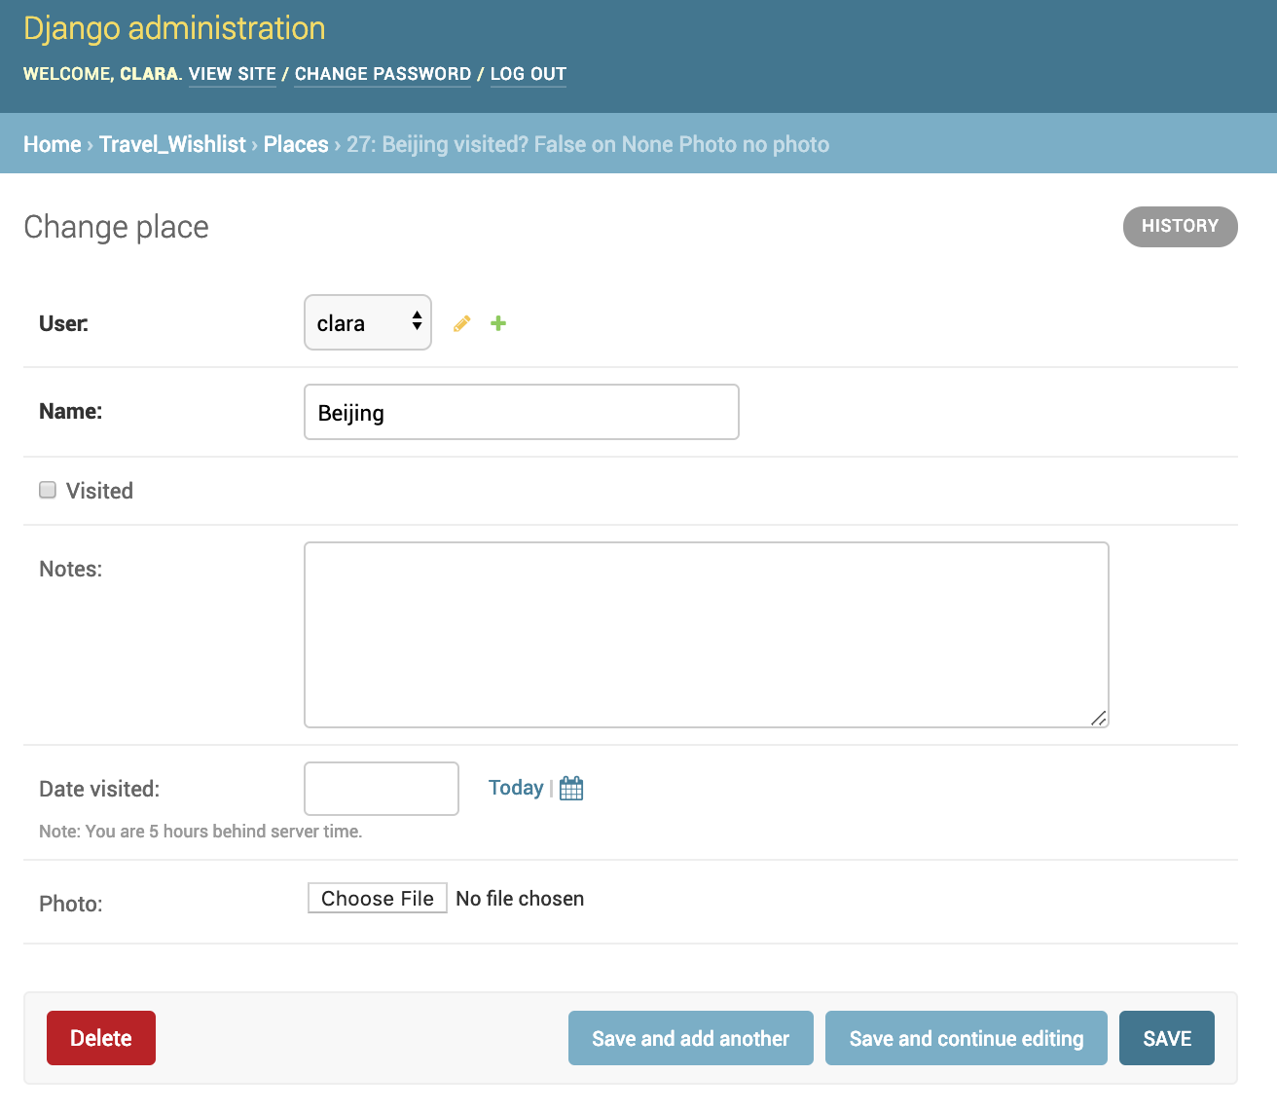
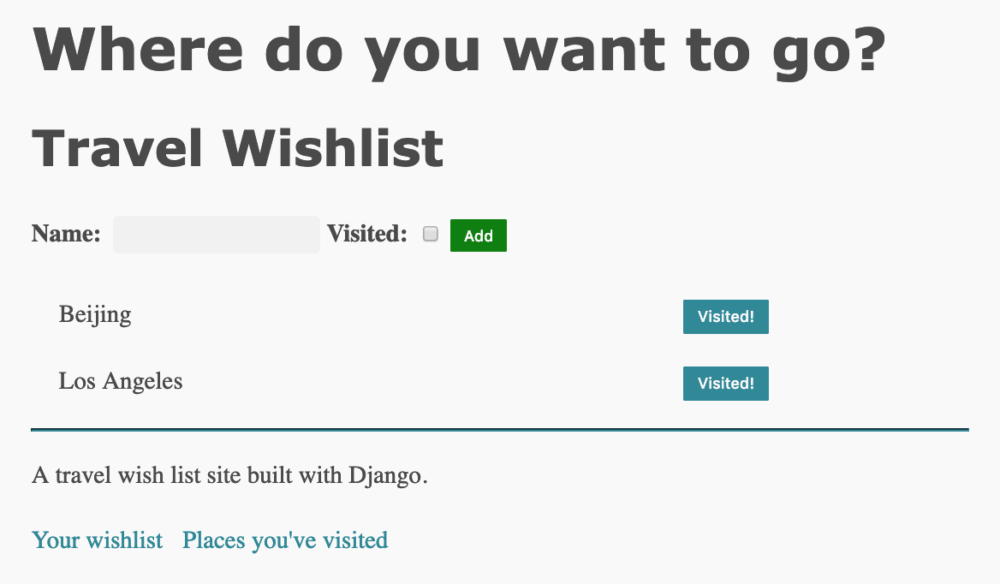
Site should still show wish list and visited places, new fields in Admin console

Slide 14
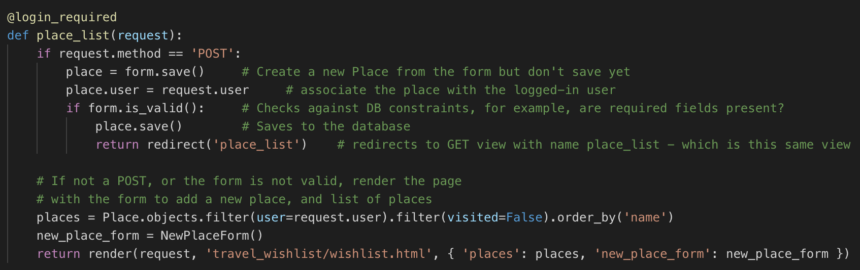
Show only this user's places - wishlist
Filter – show only this user's places

Slide 15
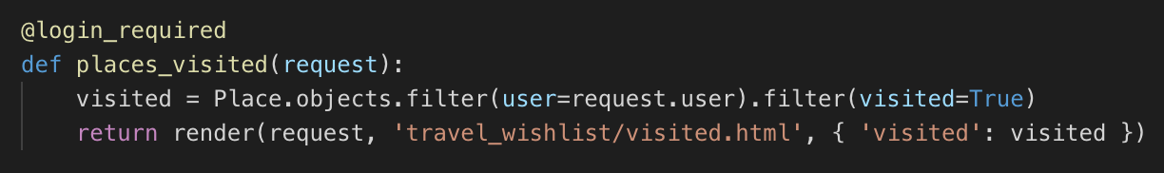
Show only this user's places - visited
Do the order of the filters matter?

Slide 16
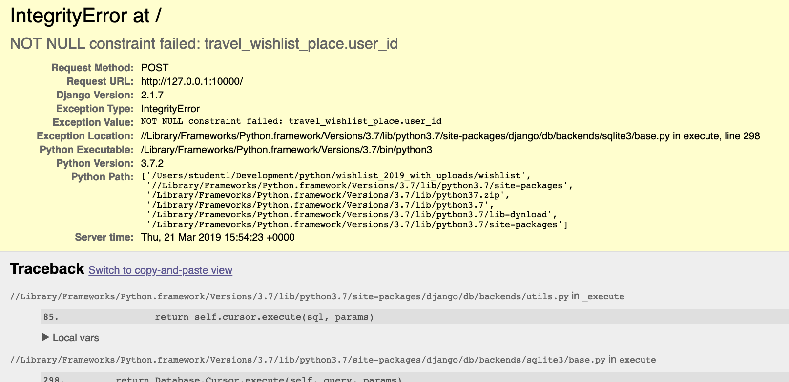
Try adding a new place from the site
What's wrong?

Slide 17
Need the user's ID to create a new place
Places need to belong to a User
When a user is logged in, Django includes the logged-in user's PK in the request object that's sent to each view function
Modify place_list, next slide

Slide 18
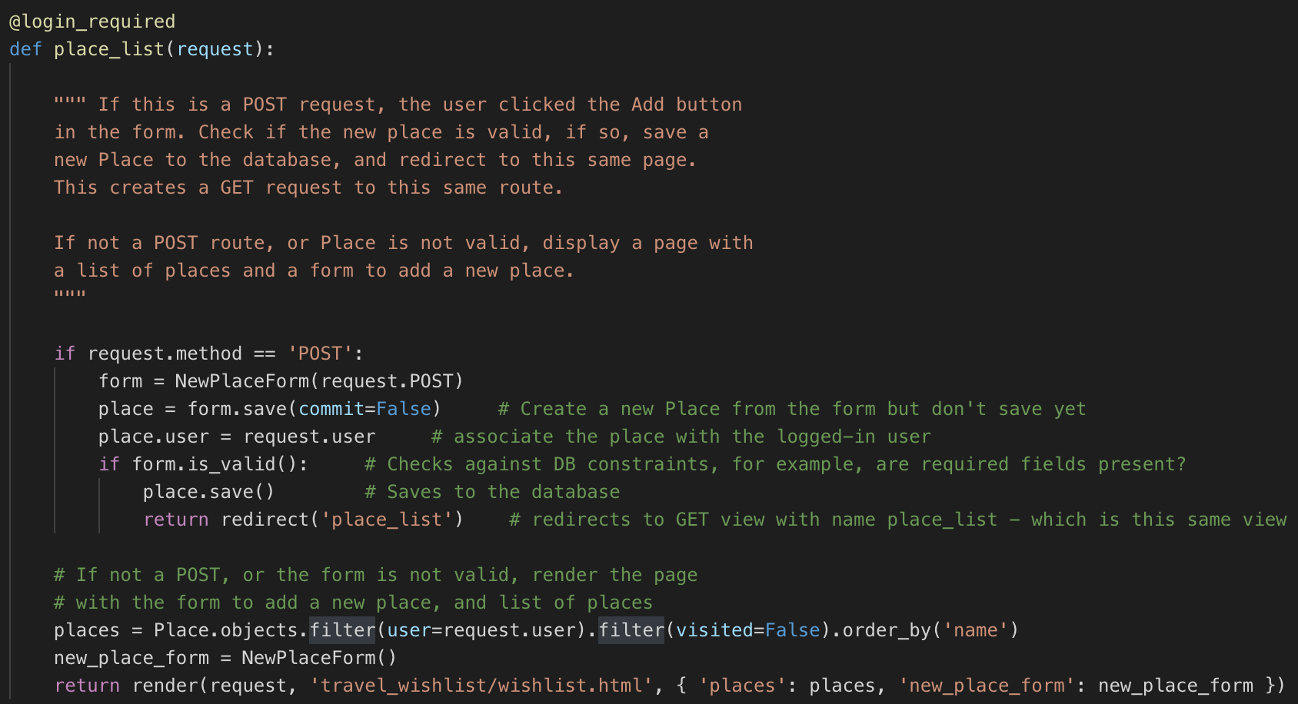
travel_wishlist/views.py
When saving the form, don't commit
Add the request's user to the Place

Slide 19
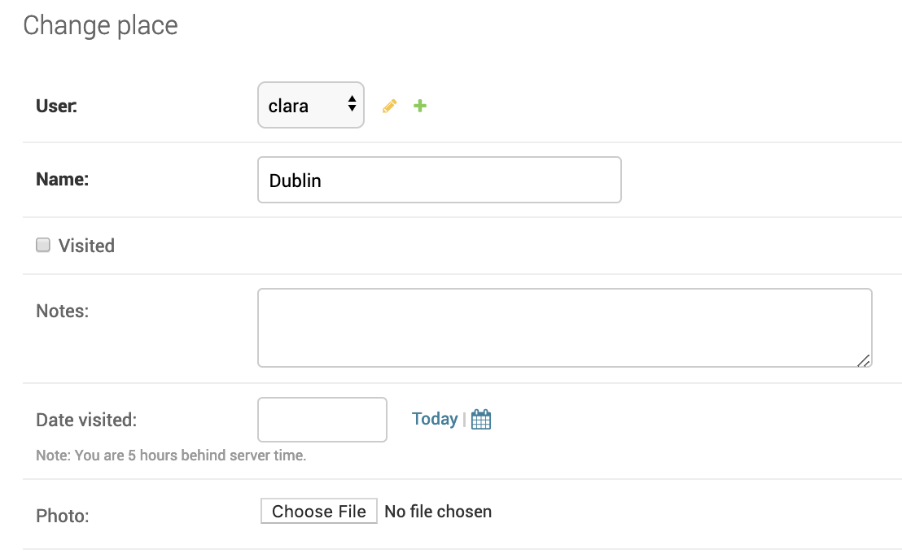
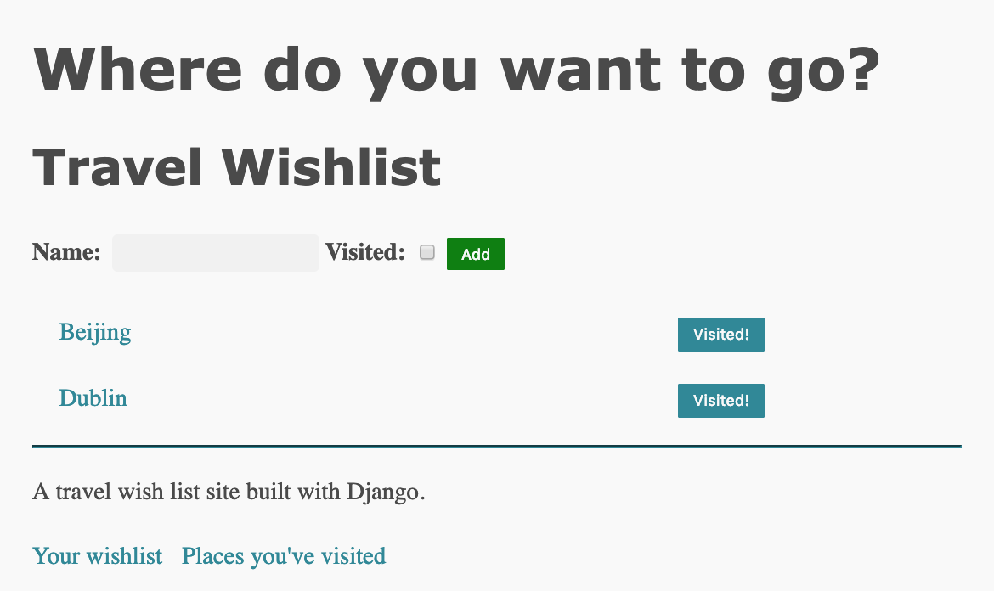
Add new place should work
Verify places are associated with the logged-in user in the admin console

Slide 20
Displaying details about a Place
Create a page for each Place
Use Place PK in URL so each Place has a unique URL
URL for the place with pk=4 will be /place/4
URL for the place with pk=20 will be /place/20
We need to create a
URL in travel_wishlist/urls.py
View function in travel_wishlist.py/views.py
Template in travel_wishlist/templates/travel_wishlist/

Slide 21
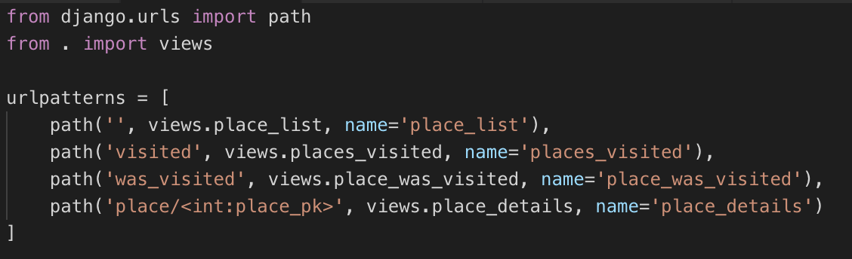
URL for place detail: travel_wishlist/urls.py
How to handle all the different URLs? /place/1, place/2, place/3 …
The URLs have the same pattern, /place/<pk>
Can describe a pattern, and capture part of the URL. Note <> syntax

Slide 22
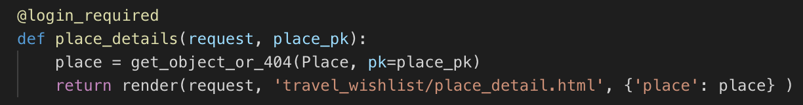
travel_wishlist/views.py
Add this function
Notice place_pk argument in function definition
When this function is called for a URL eg. /place/3, then place_pk will be captured from the URL, and the place_details function will be called with place_pk = 3
At the top of the views.py file:
from django.shortcuts import get_object_or_404

Slide 23
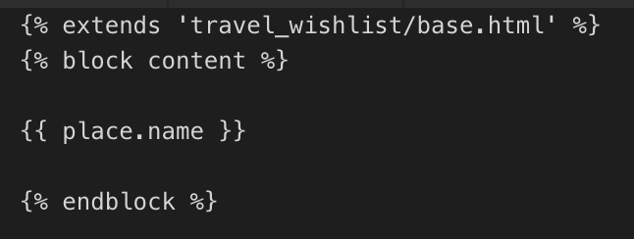
New template
Create new template in travel_wishlist/templates/travel_wishlist called place_detail.html
To check it's working, display the place name
travel_wishlist/templates/travel_wishlist/place_detail.html

Slide 24
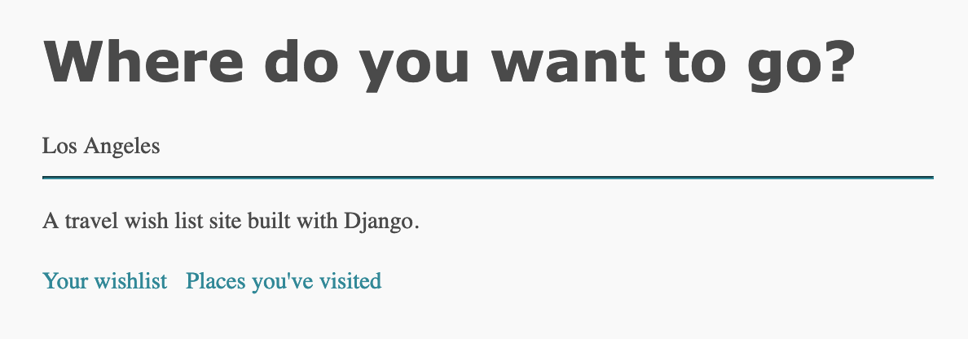
Go to http://127.0.0.1:8000/place/1
Replace 1 with a the PK of a place in your database, if you've deleted place pk=1
Place name
http://127.0.0.1:8000/place/1

Slide 25
Go to http://127.0.0.1:8000/place/10000
Replace 10000 with a the PK of a place NOT in your database, if you've created that many places
Should see a 404 Not Found error
http://127.0.0.1:8000/place/10000

Slide 26
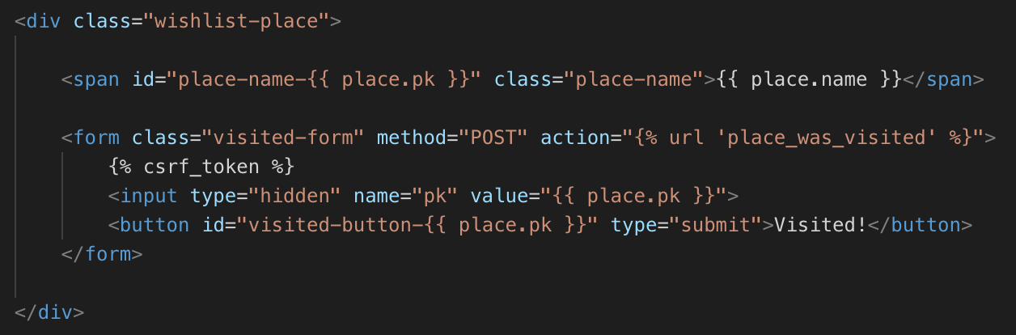
Links from wishlist.html site to detail page
At the moment, wishlist.html template looks like this
Need to add a link to the span element that shows Place.name
Your code right now – look at the element highlighted in green

Slide 27
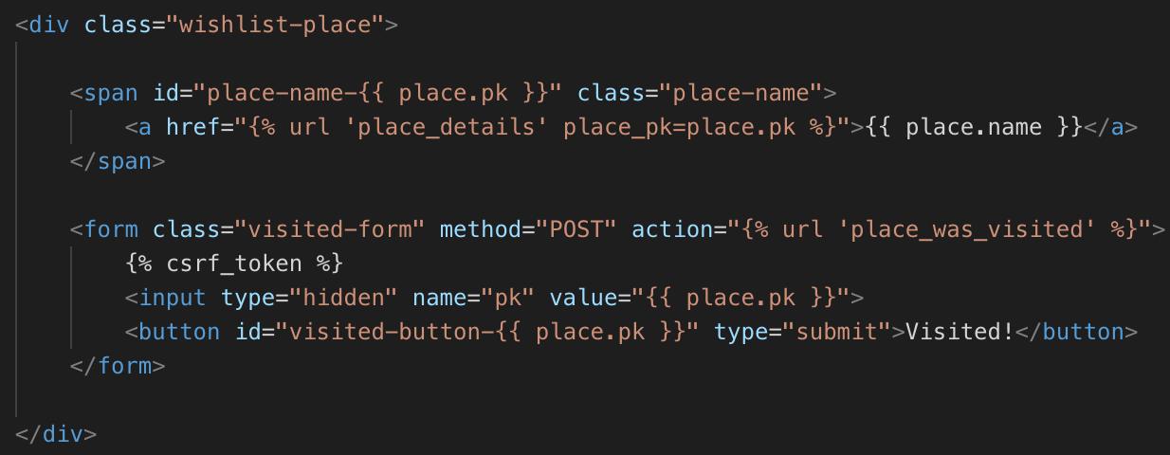
Modify this part of wishlist.html

Slide 28
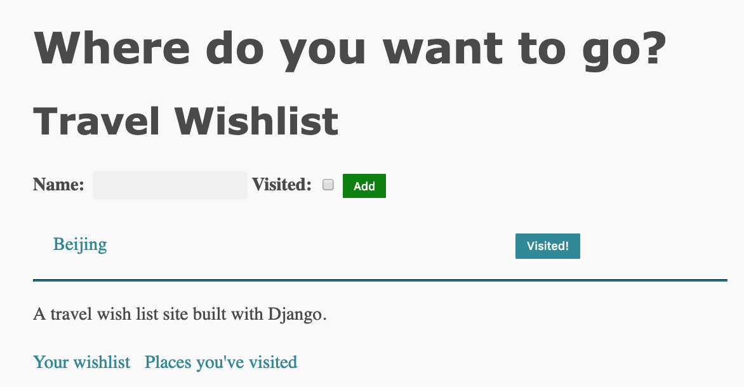
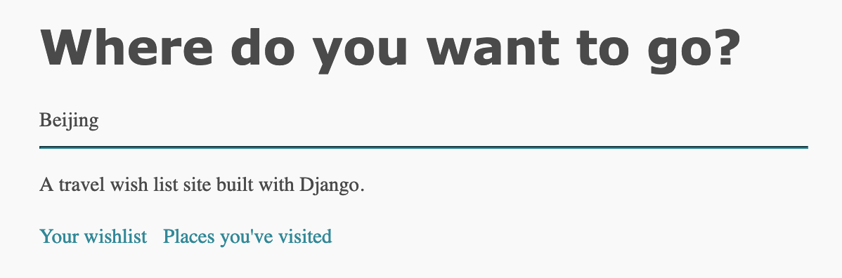
Wishlist names are now links
Run and test – each name is a link

Slide 29
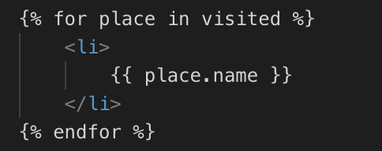
Your turn: do the same for the visited.html template
Add a link to the place detail page, surround {{ place.name }} with an a element

Slide 30
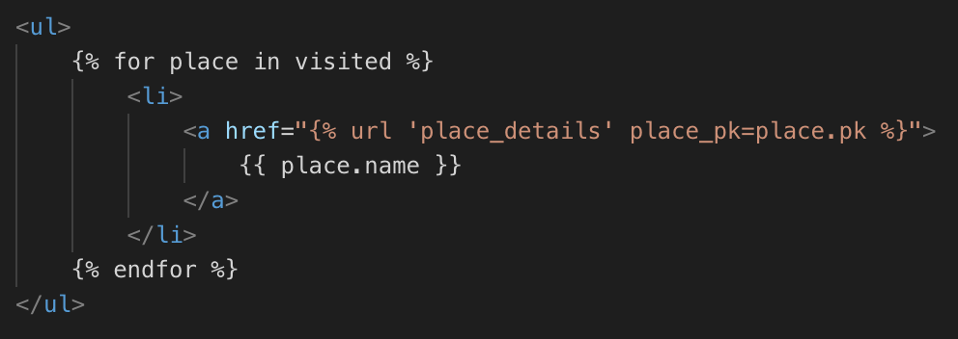
Solution
Part of travel_wishlist/templates/travel_wishlist/visited.html
Test – verify links from /visited page work

Slide 31
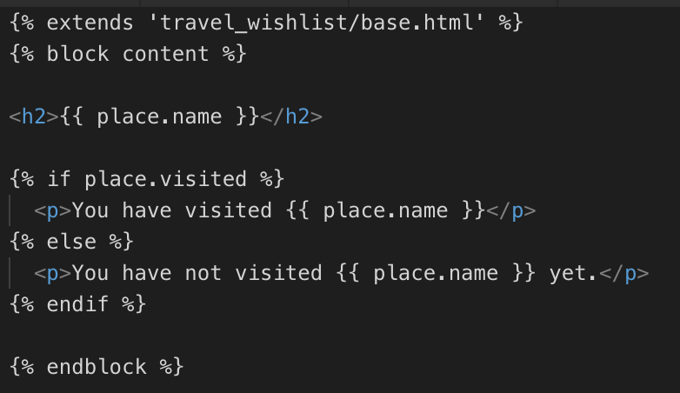
Detail should be different if the place is visited or not
Change place_detail.html to this
Note if, else, endif structure in the template
travel_wishlist/templates/travel_wishlist/place_detail.html

Slide 32
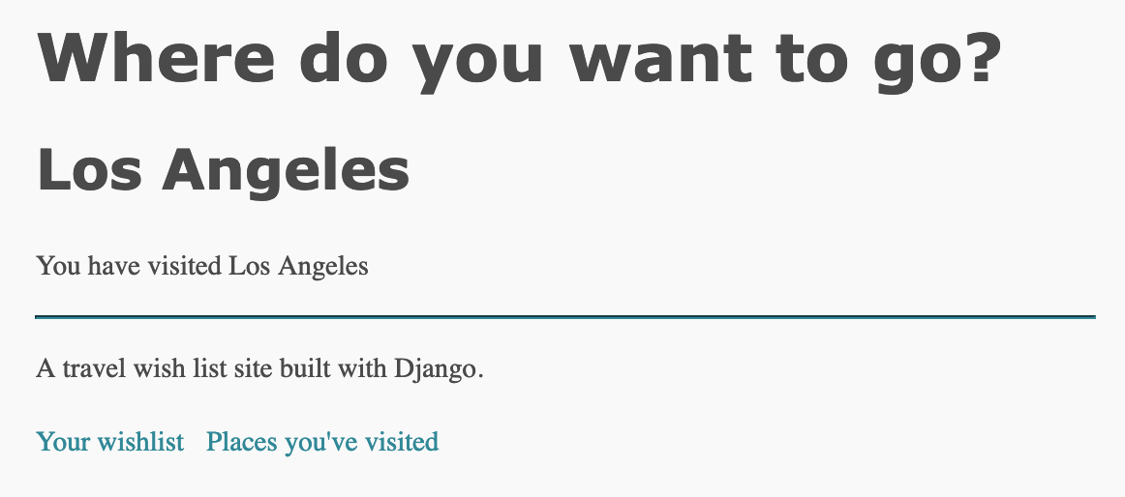
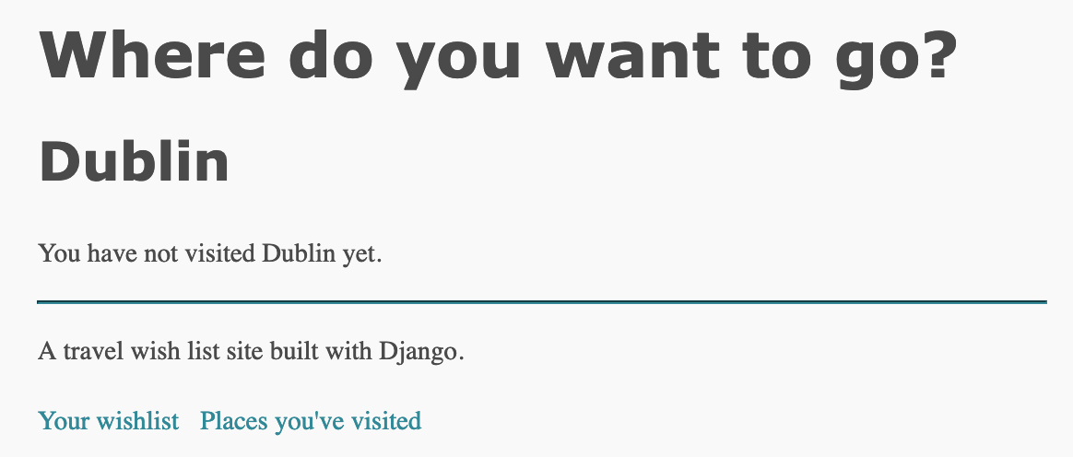
Test
Verify visited, and not-visited places have a different message

Slide 33
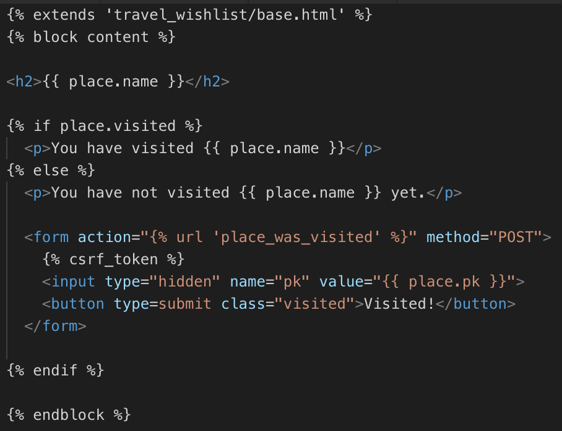
Re-use visited route, URL, view
Add a Visited! button on the place detail page, but only if the place is not visited yet
place_detail.html

Slide 34
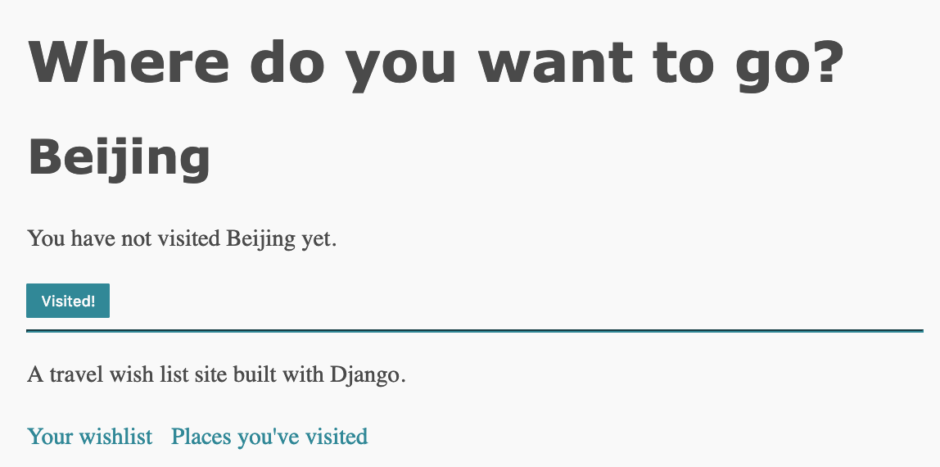
Test
Make sure button works – check Wishlist page, visited page and Admin console

Slide 35
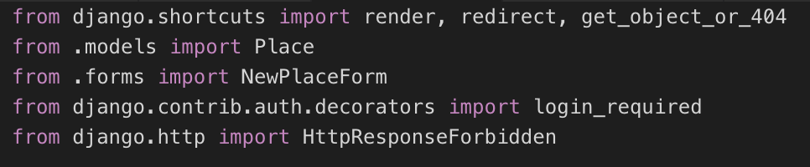
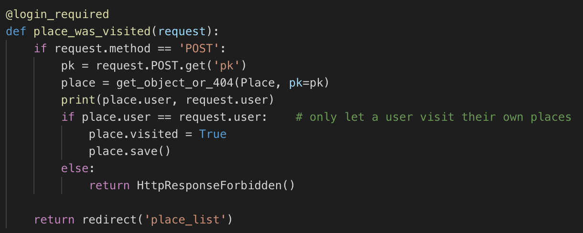
Security problem – travel_wishlist/views.py
The app lets anyone mark any place as visited
Modify view so users are only allowed to visit their own places
Check the request user matches the Place user

Slide 36
Delete button
Add a delete button to the place_detail.html template
Should be able to delete any place – visited or not
Need a new URL route, and new view

Slide 37
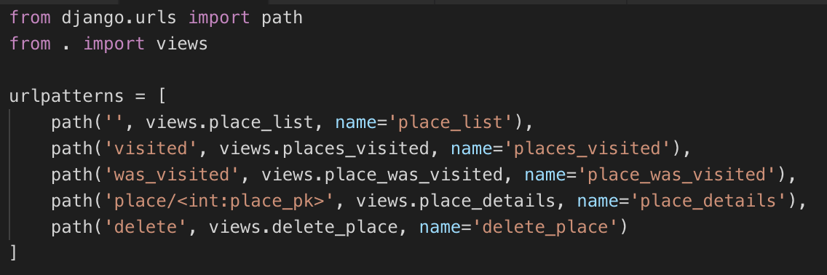
Delete – new URL
travel_wishlist/urls.py

Slide 38
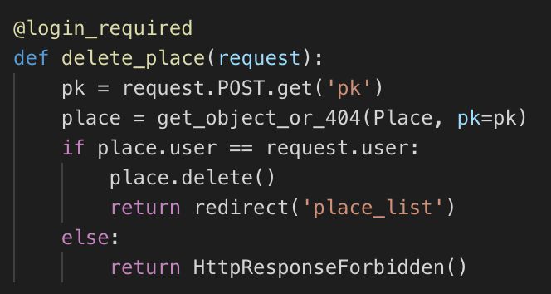
Delete – new view, travel_wishlist/views.py
Check that the user requesting the delete operation is the owner of the Place

Slide 39
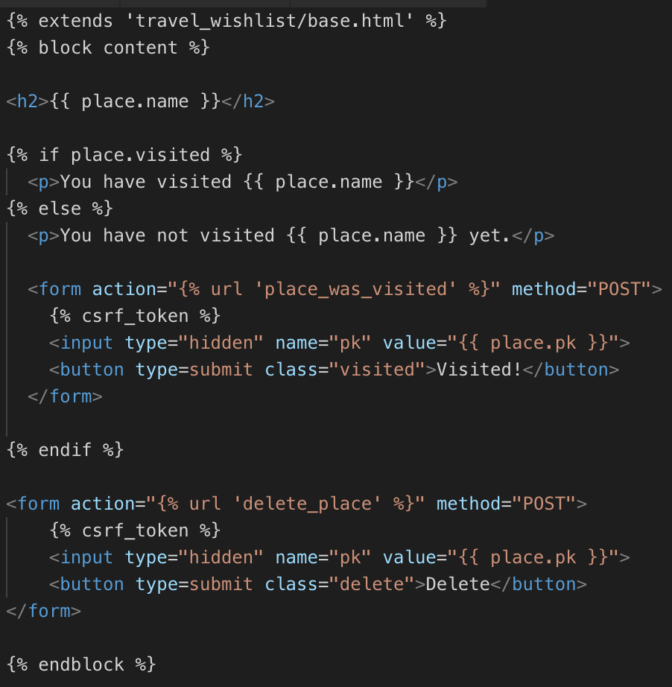
Add button to place_detail.html template
Notice it's after the {% endif %} and before the {% endblock %}

Slide 40
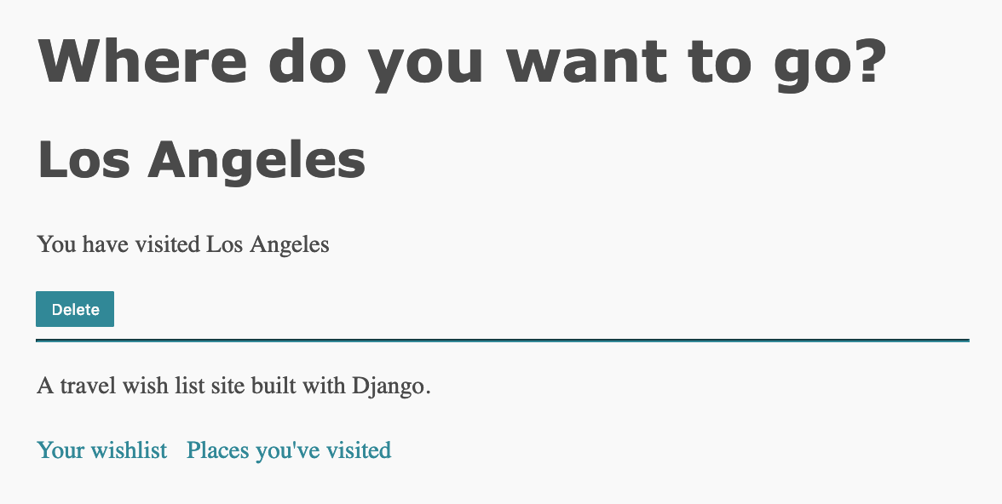
Test – delete button shown
Click the button to delete the Place
Verify in admin console
But we have a user experience (UX) issue
Deleting is a destructive action, but the button is the same blue as the visited buttons
Better to have a visual clue that this button is a destructive action
There's no confirmation before deleting
Make sure user really wants to delete, and provide a way to cancel the operation if the button was clicked by accident

Slide 41
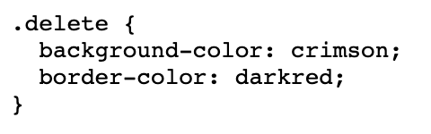
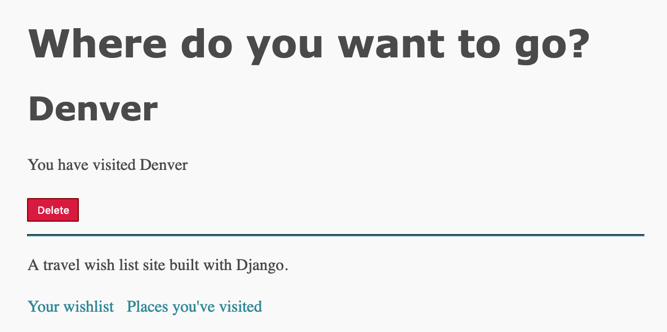
Change button color - CSS
Replace travel_wishlist/static/css/styles.css with this CSS
https://git.io/fjf7j
Includes these style rules
Button is now red
Adjust styles if desired

Slide 42
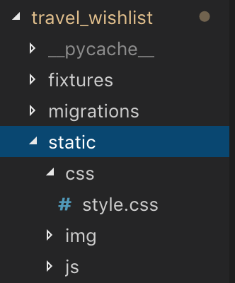
Are you sure? JavaScript (JS)
JavaScript, CSS, and decorative site images are types of static files used by websites
Every user who visits the site will be served the same JS, CSS and decorative images (e.g. logos, banners, background images)
We've already got a travel_wishlist/static/css directory
Inside the travel_wishlist/static/ directory, create two new directories: img and js

Slide 43
Static Files, Media Files and Dynamic Pages
Pages in our site are dynamic – generated by Python, by running application code, often using data from the database
If one user visits the site, they’ll see different content to another user
JavaScript, CSS, and decorative site images are static files
Every user who visits the site will be served the same JS, CSS and decorative images (e.g. logos, banners, background images)
These static files are part of our project.
No code runs to generate these files – they are pre-made
There are also media files
Images, PDFs, other files generated by our site, or uploaded by users
Media files can change, be deleted, new files added
Soon: users will be able to upload images – these will be handled as media files
When we deploy our site, we’ll need to host and serve app code + dynamic pages in a different way to hosting and serving static or media files
It’s more efficient (and cheaper) to use an app code server for Python code, and a separate static file server for static and media files

Slide 44
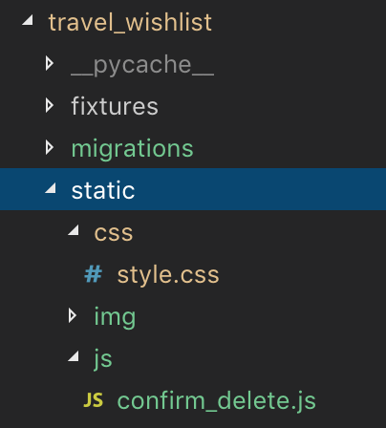
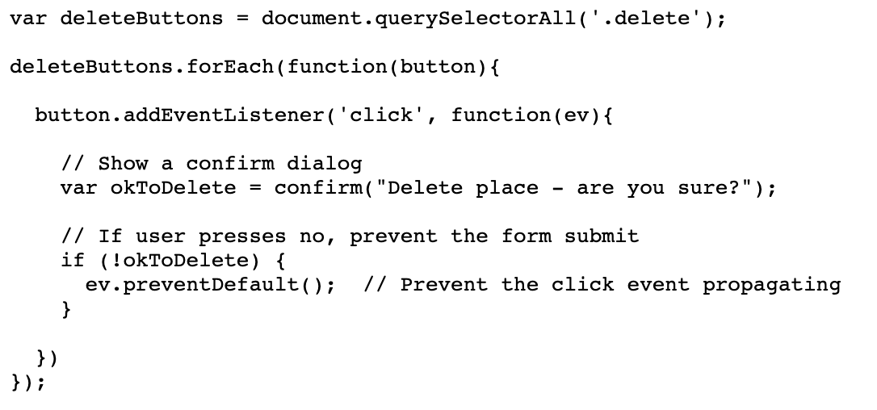
Create new file
travel_wishlist/static/js/confirm_delete.js
Get this code: https://git.io/fjf5t

Slide 45
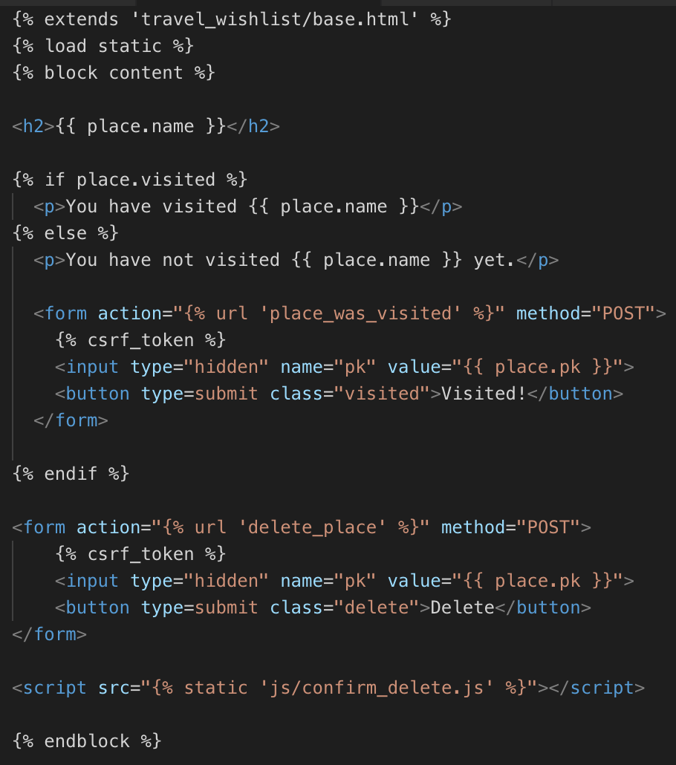
Add JavaScript code to place_detail.html
Load static files
Add script element

Slide 46
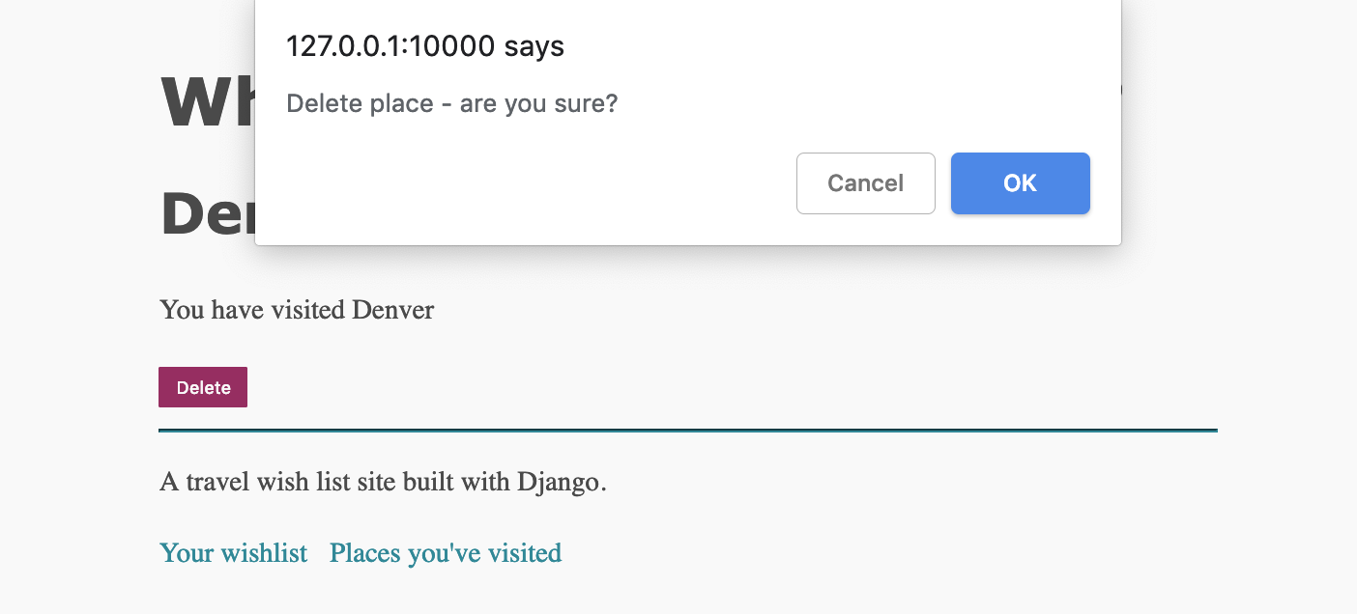
Try deleting a place
Are you sure? Alert dialog
Nothing is deleted if you press Cancel
Place is deleted if you press OK

Slide 47
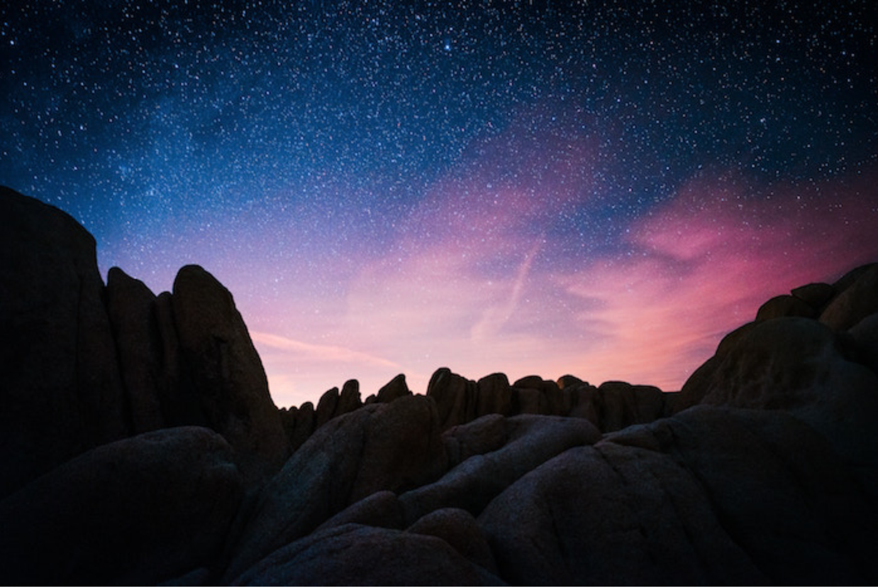
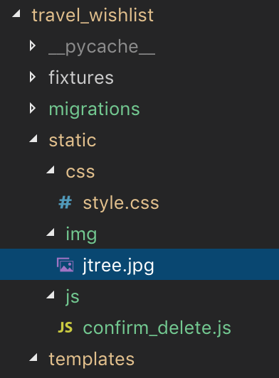
Download decorative image for site heading
Either this image, or another image of your choice
https://git.io/fjf5T
Save in
travel_wishlist/static/img/ as jtree.jpg
To use another image: https://unsplash.com is a good resource for free, high-quality images
Photo by Pawel Nolbert on Unsplash

Slide 48
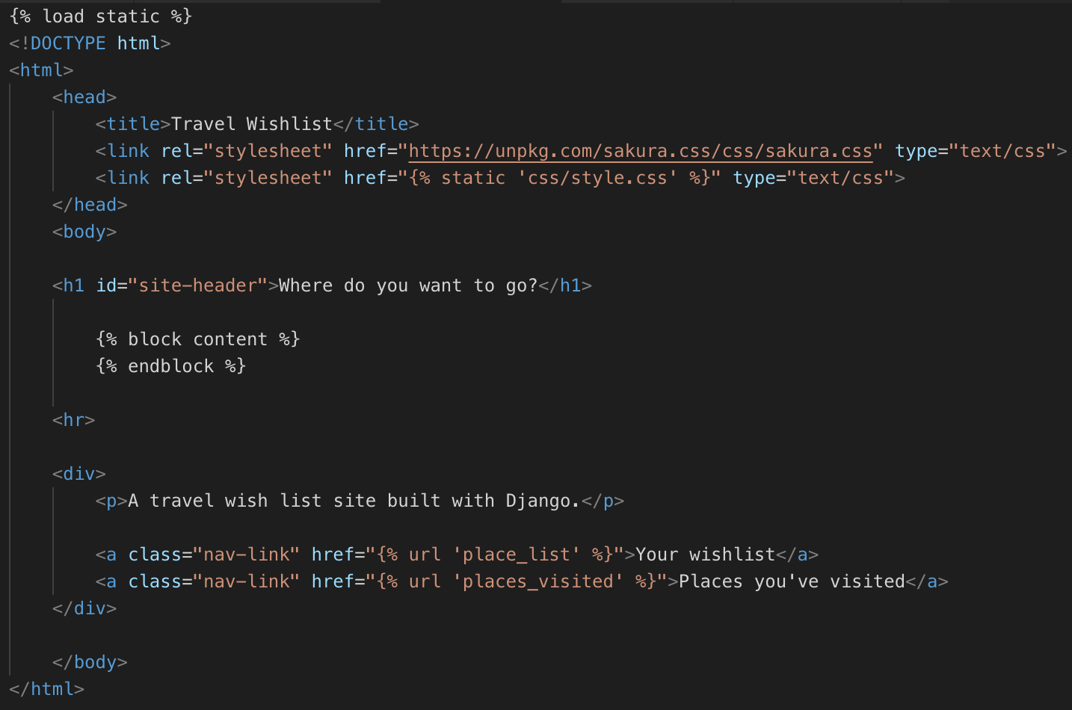
Display image behind site header text
In base.html, give the h1 element the id="site-header"
wishlist/travel_wishlist/templates/travel_wishlist/base.html

Slide 49
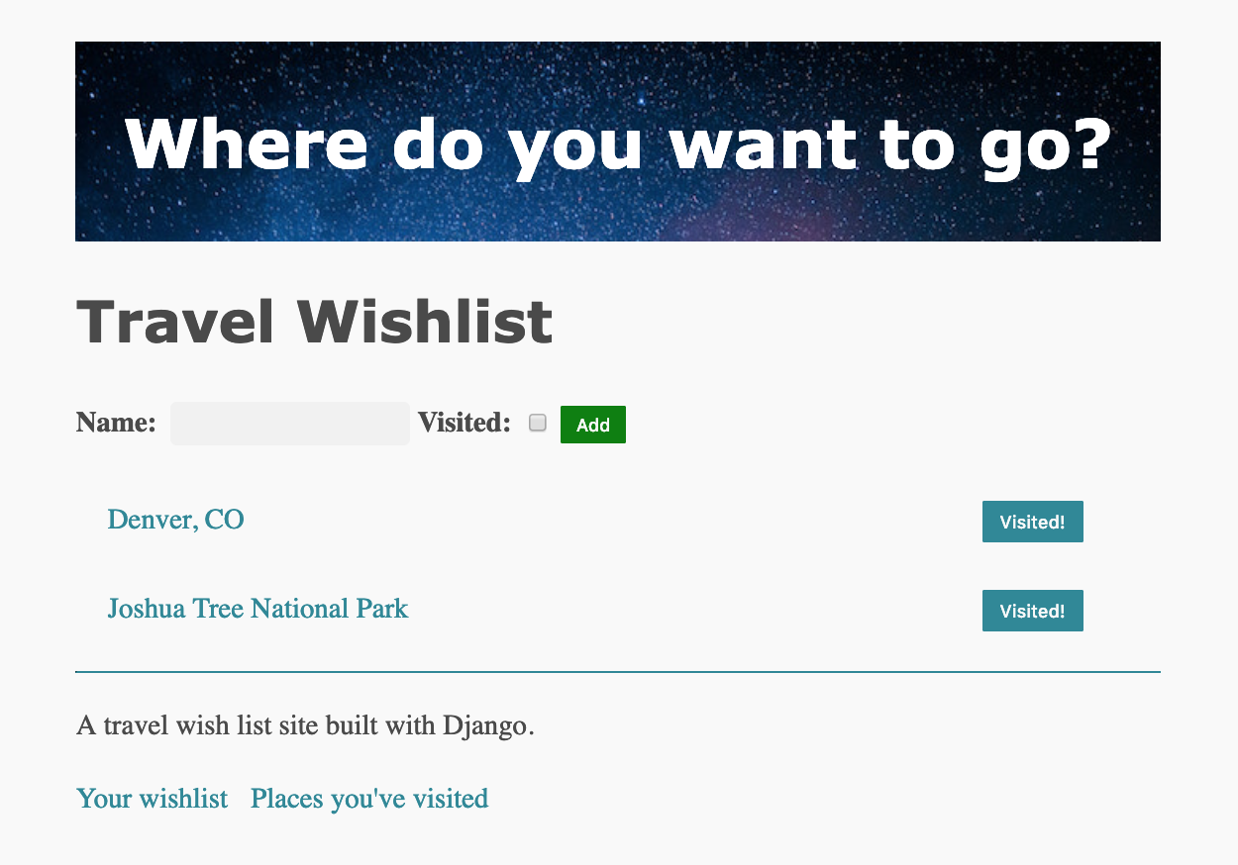
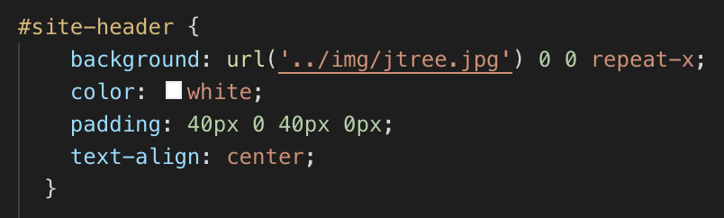
Image displayed on site
Styles for header are from the new style.css file you just added
If you used a file with another name, change it in the CSS

Slide 50
Trip Review Form
Will be displayed on the detail page, for places that have been visited
User can enter the date they visited the place
Notes
Upload a photo
All fields are optional
Use can edit the information or change the photograph

Slide 51
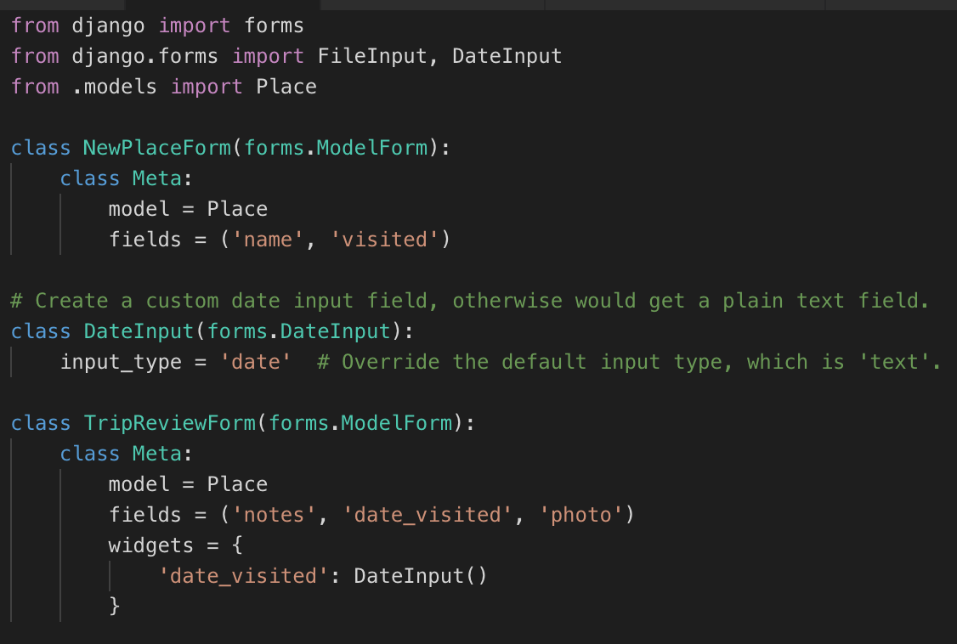
Form to update user's notes, photo, date visited
Need new form
Add to travel_wishlist/forms.py
By default, Python displays date inputs as plain text. The extra DateInput class overrides this and uses a HTML date element instead https://docs.djangoproject.com/en/2.1/ref/forms/widgets/#dateinput

Slide 52
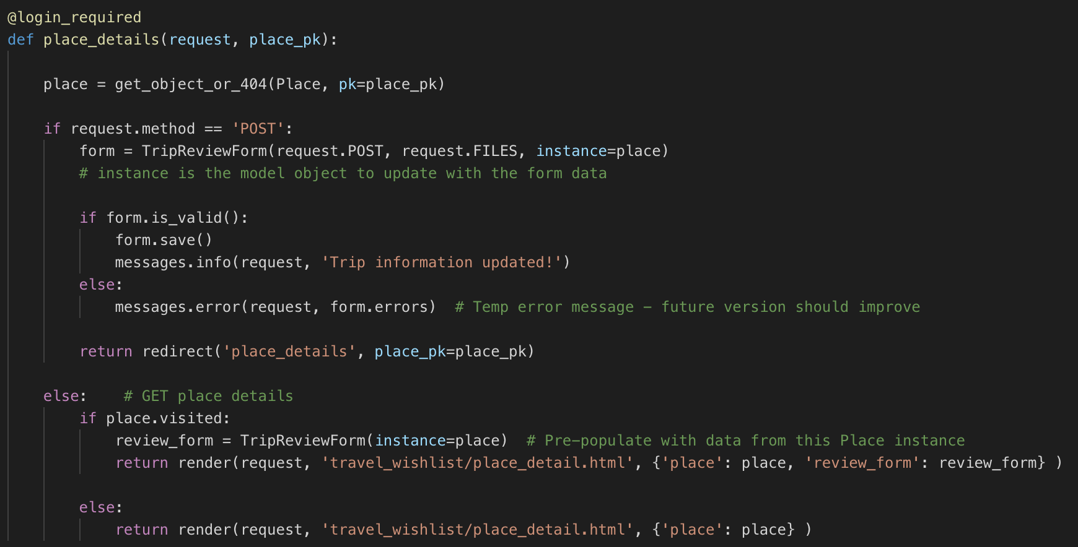
travel_wishlist/views.py Modify place_detail route import TripReviewForm at the top of the file, and from django.contrib import messages

Slide 53

Display form in the template: place_detail.html
Replace only the part of the template in the {% place.visited %} block with this
Full code listing at https://git.io/fjf5Q

Slide 54

Trip review form
Data is saved
Can edit data in form and save
Date, and notes work
Photo upload doesn't work yet – you can upload a photo, but the page displays a broken link

Slide 55

settings.py
Add the last two lines

Slide 56

wishlist/urls.py - this is the main project urls.py
Add static URLs for media files
We'll revisit this when we deploy this site – won't be able to use the host server file system

Slide 57

Now, try to upload image
Should be uploaded and displayed on page

Slide 58


New media/user_images directory created
Notice same directory name as defined in model ImageFileField

Slide 59
Media vs static
Static files – part of the application; usually same files served to every user who visits any one page
You know how many files you have
Provide files as part of the application
Media files – may be user uploads, or dynamically generated. Can be images, music, binary files, word documents, PDFs, 3D printer files...
Files can change often, storage space needed is less predictable
Created, edited, modified as application runs
Deployed sites often handle static and media files separately

Slide 60
Images working
Try changing the image
Or, delete a place that has an image
What happens to the files that are uploaded?
Previous image is still saved in the project

Slide 61

Deleting photo files when photo is replaced for a Place
Override save method of model
Find the previous version of the Place, if it exists
If there's a previous place with a photo, then delete it

Slide 62
Test – add a photo, and replace it
The first photo should be deleted, the new photo should be saved
Check your file system
Modify another field of a place (like the trip report, or the date visited) – photo should NOT be deleted

Slide 63

Deleting a Place
Add this method to the place model

Slide 64
Test – delete a place with a photo
Verify photo is removed from the file system

Slide 65
Unit Tests
In the repository
Run with python manage.py test
Do they pass?

Slide 66
Functional Tests
Only test the features from part 1
But should still pass
Contributions for new functional tests are welcome!

Slide 67
Lab
Make sure you have a running version of this site for next time
We’ll deploy your site to Amazon Web Services
Make sure you have an Amazon Web Services (AWS) account and you have applied for free student credit, and applied that credit to your account
This is NOT the same as an Amazon store or Amazon Student account

